Slide 1
IoT Camp San Jose
Connect the Dots Deck Template

Slide 2
Logistics stuff
We’ll figure the network out as we go:
For now, you can connect to the WiFi :
SSID msiotcamp
PWD msiotcamp
Or you can plug into an Ethernet cable
You may have to change your connection when we get into the labs
I have a site with notes, etc. At http://aka.ms/iotcampsjc

Slide 3
Overview
Listen to me talk
Watch me do a demo
Go do the Labs

Slide 4
What is the “internet of things”
Internet of things
Syllabification (Inter•net of things) noun
A proposed development of the Internet in which everyday objects have network connectivity, allowing them to send and receive data: “If one thing can prevent the Internet of things from transforming the way we live and work, it will be a breakdown in security.”
Source: Oxford Dictionary, yep, it’s really in the Oxford Dictionary. It got added at the end of August, 2013

Slide 5
Cisco’s Definition
“Bringing together people, process, data and things to make networked connections more relevant and valuable than ever before”
Source: Cisco

Slide 6
A phrase coined
Kevin Ashton first used the phrase “Internet of Things” in a 1999 presentation on RFID & the Supply Chain at Proctor and Gamble
Later, in 2009, he wrote about what he intended the phrase to mean in an article he wrote for RFID Journal entitled: “That ‘Internet of Things’ Thing: In the real world, things matter more than ideas”
Source: Kevin Ashton, “That ‘Internet of Things’ Thing: In the real world, things matter more than ideas”, RFID Journal, June 2009

Slide 7
“Today computers—and, therefore, the Internet—are almost wholly dependent on human beings for information. Nearly all of the roughly 50 petabytes (a petabyte is 1,024 terabytes) of data available on the Internet were first captured and created by human beings—by typing, pressing a record button, taking a digital picture or scanning a bar code…”

Slide 8
“If we had computers that knew everything there was to know about things—using data they gathered without any help from us—we would be able to track and count everything, and greatly reduce waste, loss and cost. We would know when things needed replacing, repairing or recalling, and whether they were fresh or past their best.”

Slide 9
“We need to empower computers with their own means of gathering information, so they can see, hear and smell the world for themselves, in all its random glory. RFID and sensor technology enable computers to observe, identify and understand the world—without the limitations of human-entered data.”

Slide 10
A rose by any other name
Pervasive Computing
Ubiquitous Computing (ubicomp)
Internet of Things (IoT)
Internet of Everything (IoE)
Machine to Machine (M2M)
Industrial Internet

Slide 11
CONNECTED “THINGS” vs people
2013 - Est. 10 Billion CONNECTED Devices
vs. Est. 7.14 Billion People World Population
Est. 50 Billion connected devices in 2020
More connected devices than connected people
2003
2008
2015
2020
Source: Cisco & Internet World Stats

Slide 12
enablers
Moore’s Law
Low Power Wireless
Low Power CPUs
Standards
Cloud Computing
Cloud Data Storage
Crowdfunding
Toolsets & Libraries
Rapid Prototyping
Notes:
Moore’s Law (amount of computing power / sq in.)
Low Bandwidth / Low Power Wireless Networking
Lower Power CPUs (Intel, ARM)
Cloud Computing
Cloud Data Storage
Big Data – Hadoop
Convenient prototyping (Arduino, Netduino, 3D Printing)
Standards (MQTT / OMA-DM)
Toolsets (m2m.eclipse.org)

Slide 13
Devices & things
Let’s see some cool stuff!

Slide 14
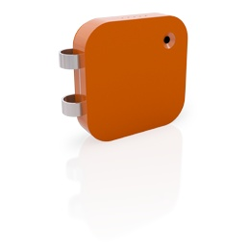

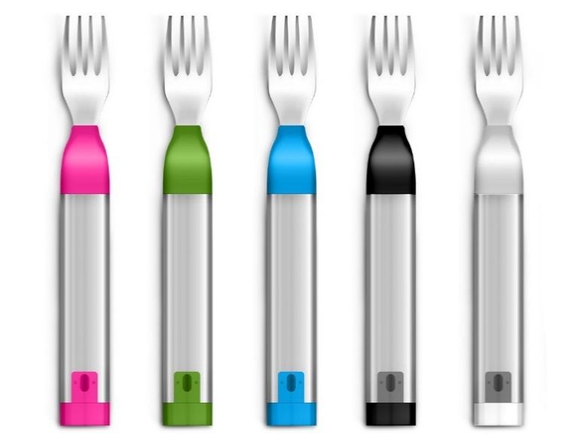
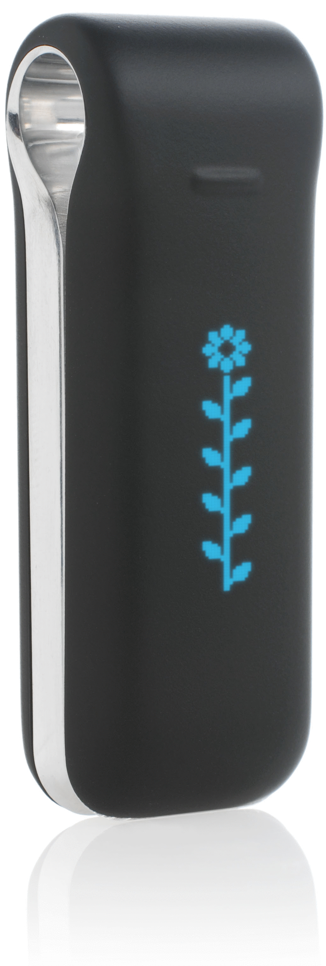


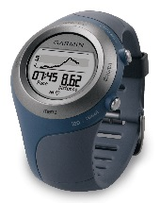
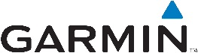
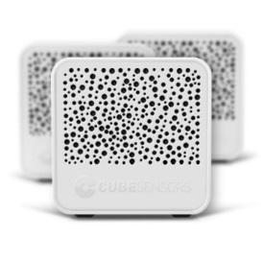
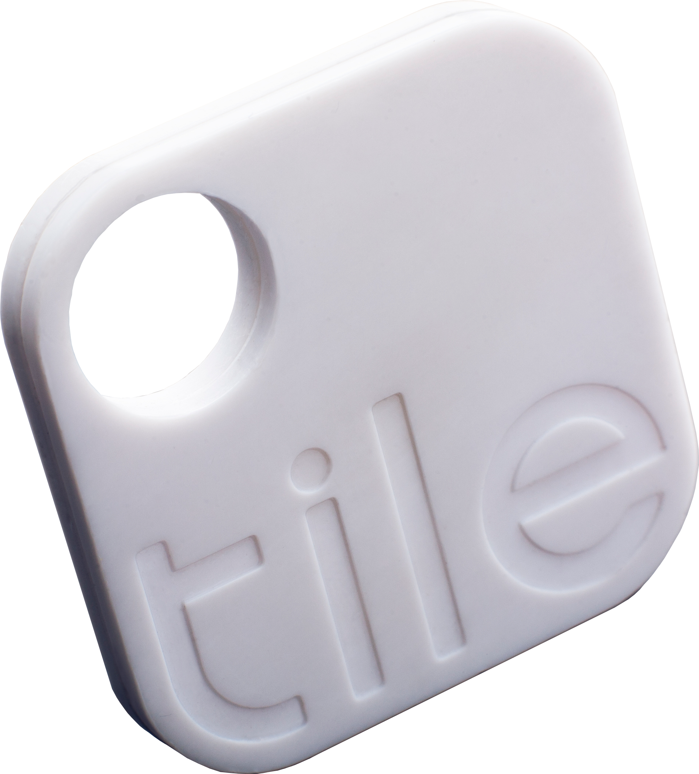
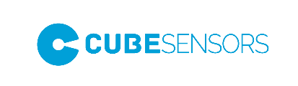

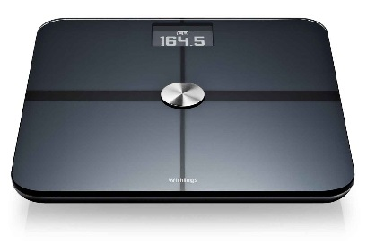

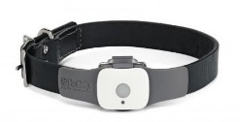
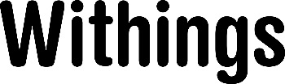
The Quantified self

Slide 15

Heineken’s “Smart bottle”

Slide 16
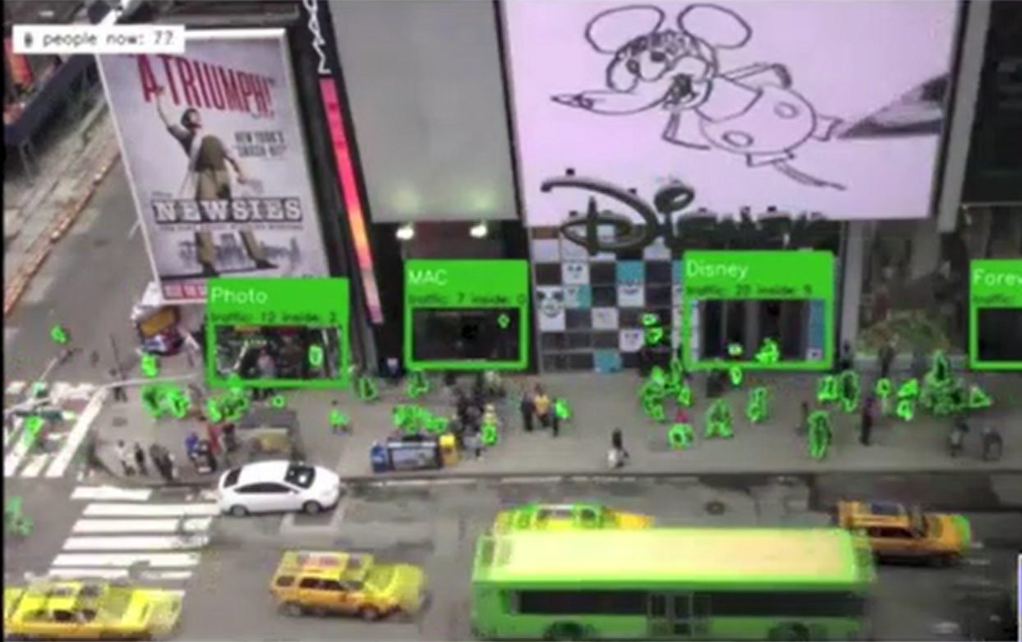
Placemeter

Slide 17
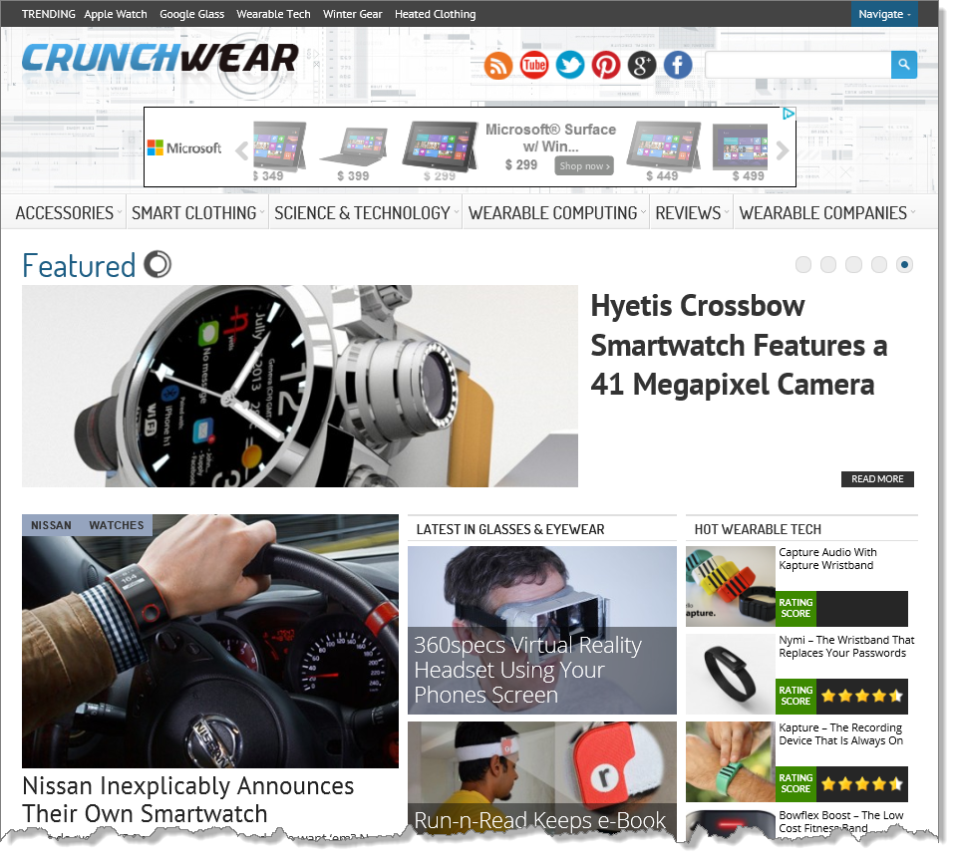

Slide 18
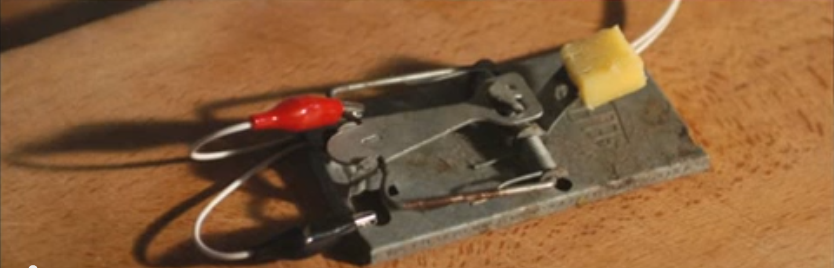
Building a better mousetrap
Source: “TEDx Warwick – Andy Stanford-Clark – Innovation Begins at Home”

Slide 19

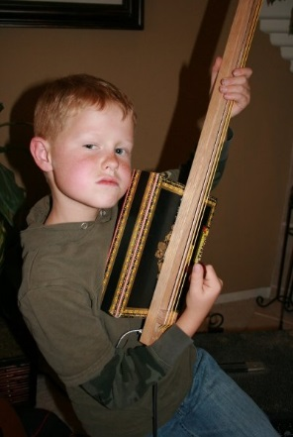
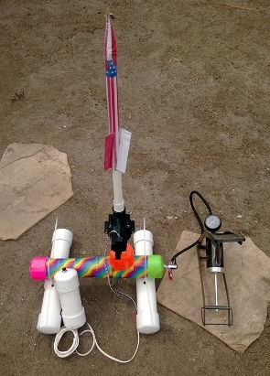
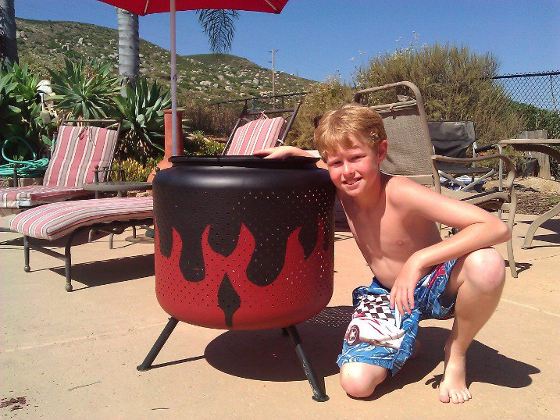


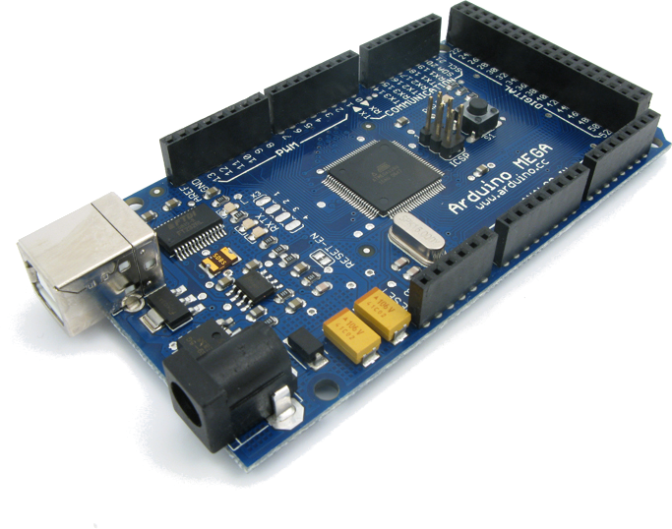
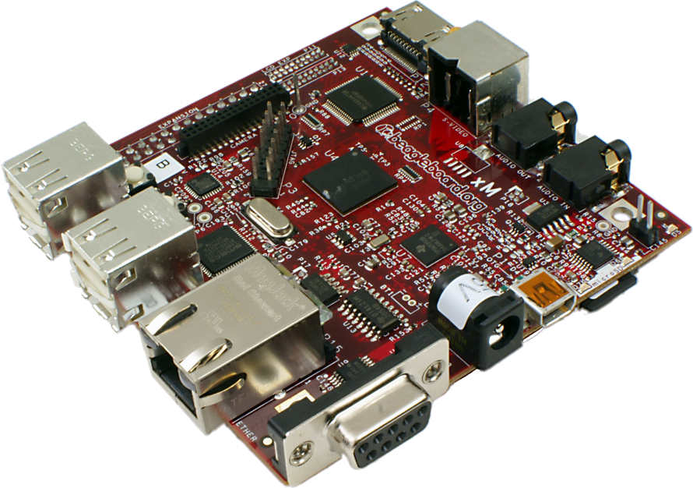

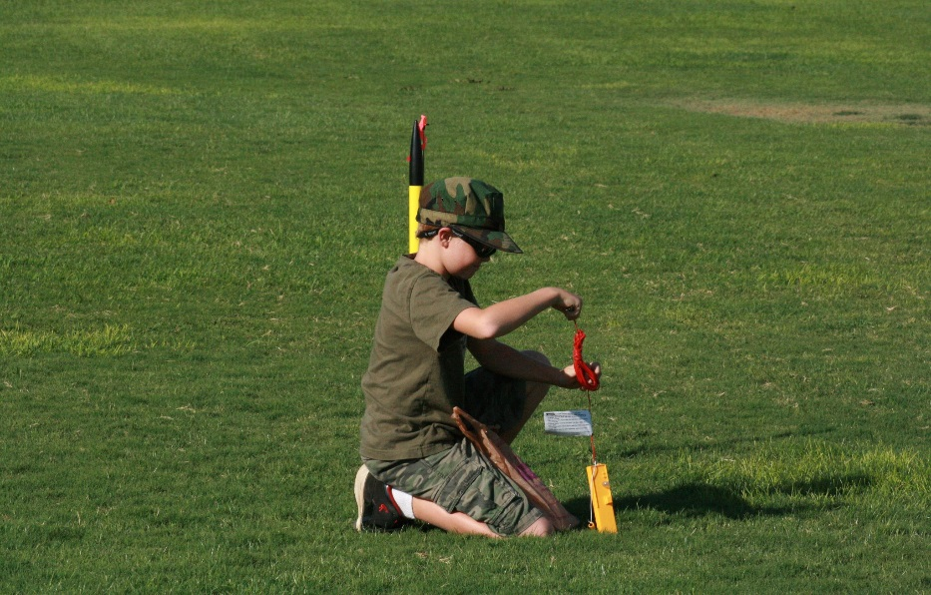
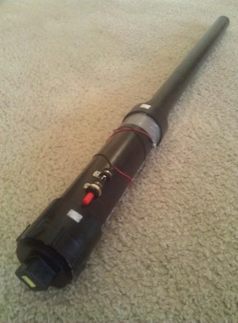
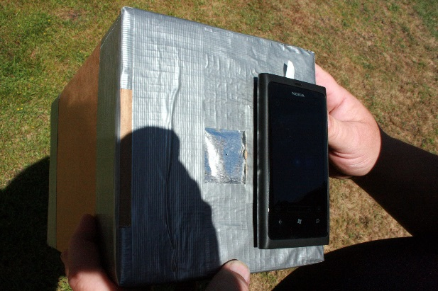




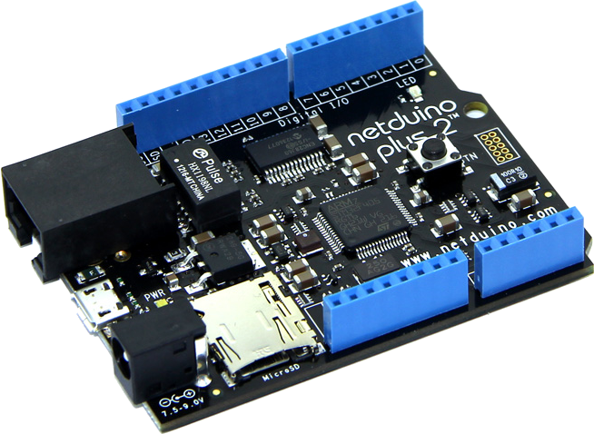

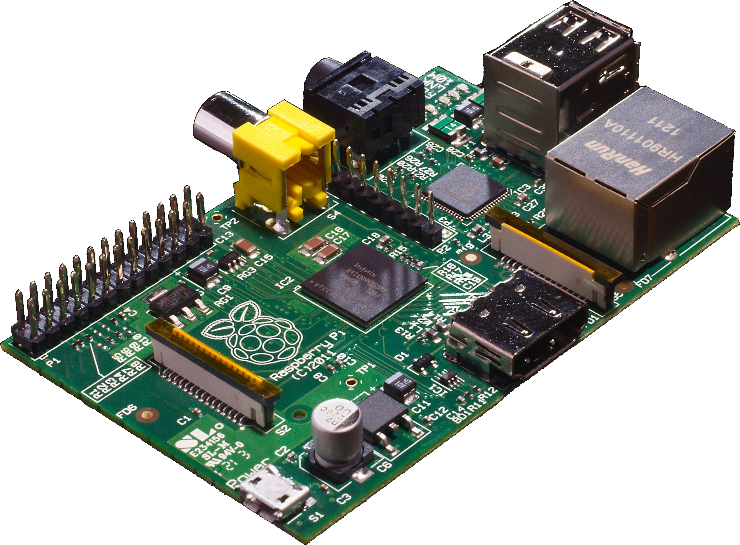
THE MAKER REVOLUTION

Slide 20
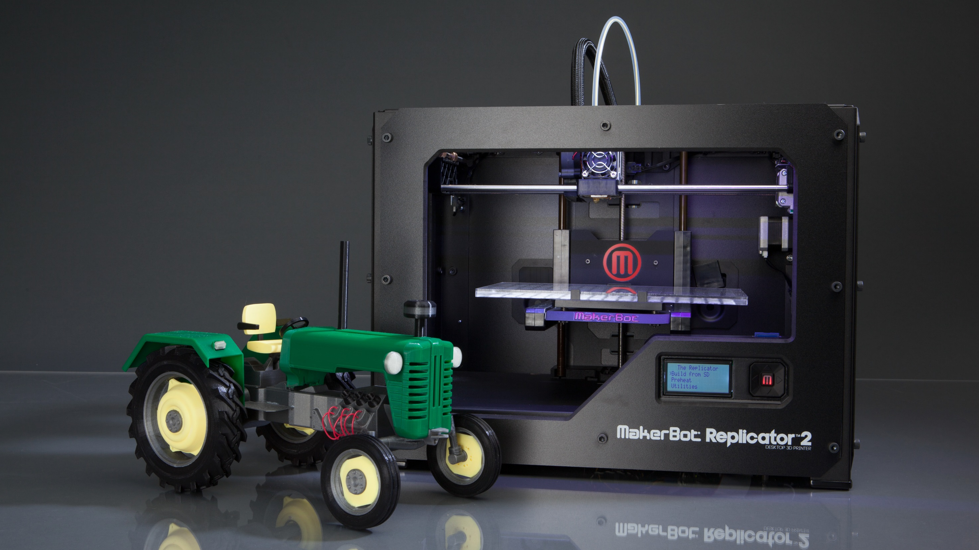
3D printing & milling

Slide 21
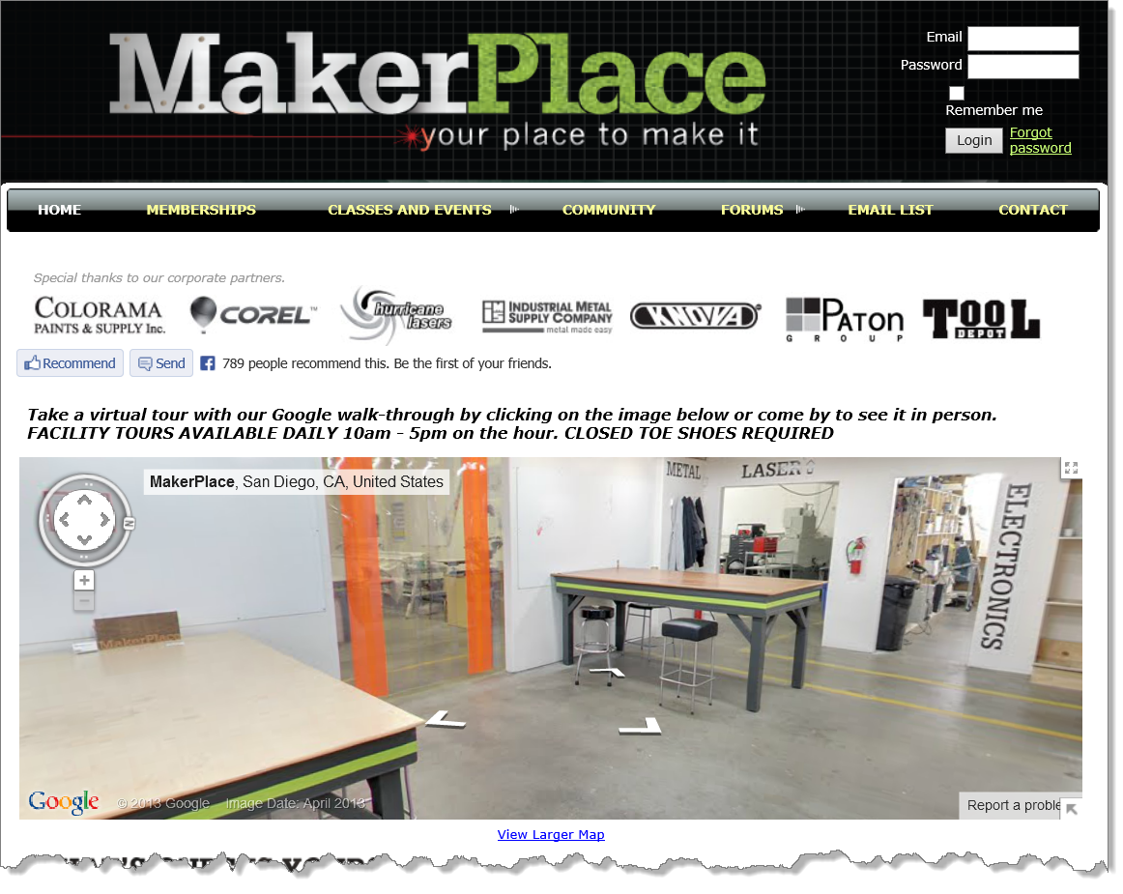
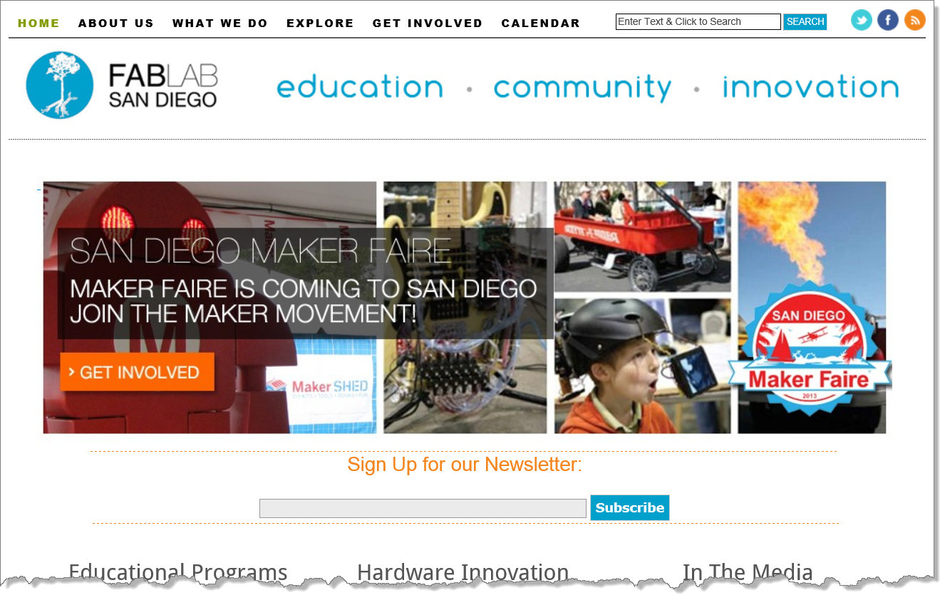
Maker spaces, places and FAIRES
Not just for adults! Many of these places make significant efforts to educate kids from elementary school age and up. Often this is made possible by STEM (or STEAM) grants.

Slide 22

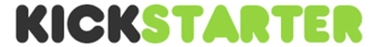
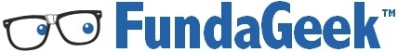
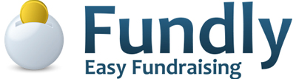

Crowdfunding
Since starting in 2009….
48,000 Projects
4,800,000 People
$777,000,000 Pledged
44% Projects Reached Goal
$274,391,721 Collected in 2012
Source: Kickstarter

Slide 23
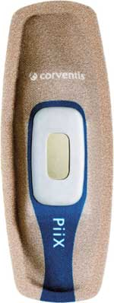

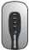
Medical applications
Wireless cardiovascular solutions
Source: Corventis

Slide 24
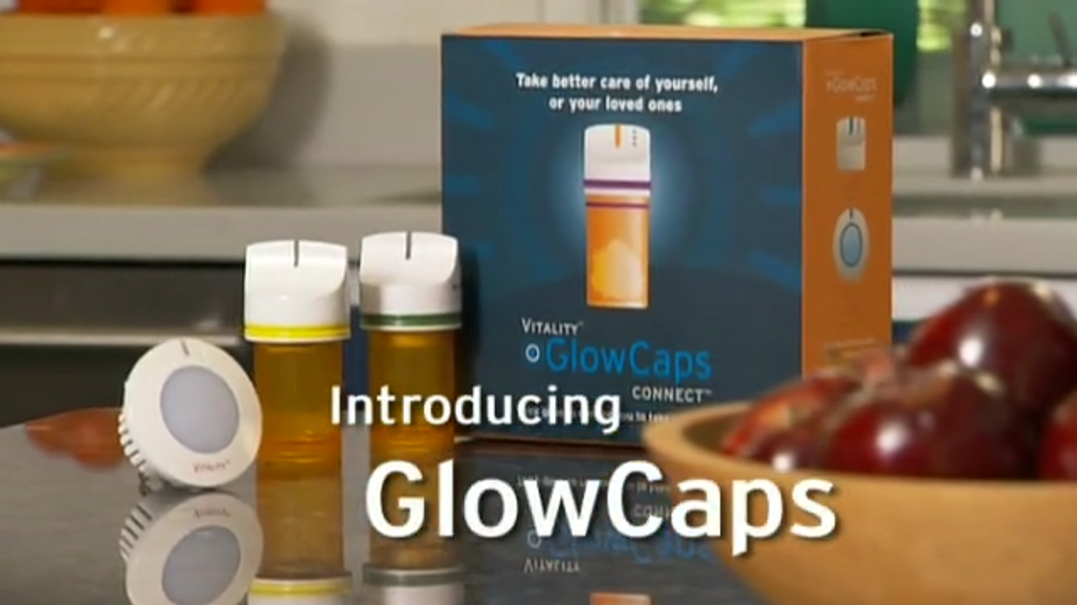
Smart pills (ok, pill bottle caps)
Check out GlowCaps or Video

Slide 25
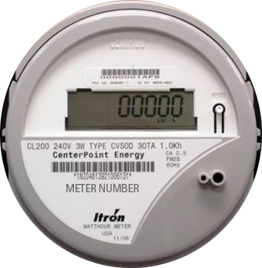
Smart grid

Slide 26
Other domains
Automated Transportation Smart Cars
Smart Transit
Smart Grid
Smart Home
Predictive Maintenance
Agriculture Smart Cows & Smart Corn
Military
Smart City

Slide 27
How do they communicate?
What are the networking protocols and standards that make this work?

Slide 28
Connection paths
Home automation,
Self Tracking, etc.
People
P2M
Machines (things)
P2P
M2M
Social Networking
Email, Skype, etc.
Smart Grid, Smart Home, etc…

Slide 29
Ipv4 (32bit) address space
4,294,967,295 or 4.3 Billion Addresses

Slide 30
Ipv6 (128bit) address space
Remember, we’re only talking about trillions of devices!
and billions of people!
Undecillion
Decillion
Nonillion
Octillion
Septillion
Sextillion
Quintillion
Quadrillion
Trillion
Billion
Million
Thousand
Hundred
340,282,366,920,938,463,463,374,607,431,768,211,456 or 340.3 Undecillion Addresses

Slide 31
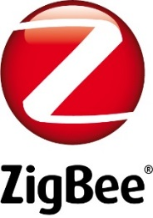
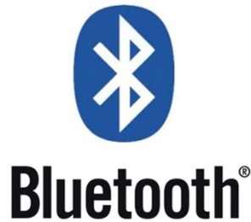


wireless, SWARMS, and CLOUDS
Want to know more? Check out Cisco’s Flavio Bonomi’s “Emerging Trends in Wireless in the Era of IoT”

Slide 32
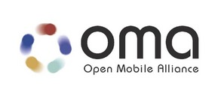

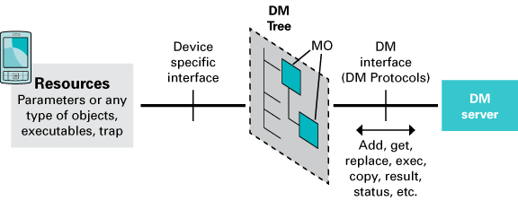
standards
Created by Dr. Andy Stanford-Clark of IBM and Arlen Nipper of Arcom in 1999
The OMA Device Management (DM) Working Group specifies protocols and mechanisms to achieve the management of mobile devices, services access and software on connected devices.
Undergoing the OASIS standardization process
Message Queuing Telemetry Transport (MQTT) is a lightweight broker-based publish/subscribe
messaging protocol designed to be open, simple, lightweight and easy to implement.
Where the network is expensive, has low bandwidth or is unreliable
When run on an embedded device with limited processor or memory resources
http://openmobilealliance.org/about-oma/work-program/device-management/

Slide 33
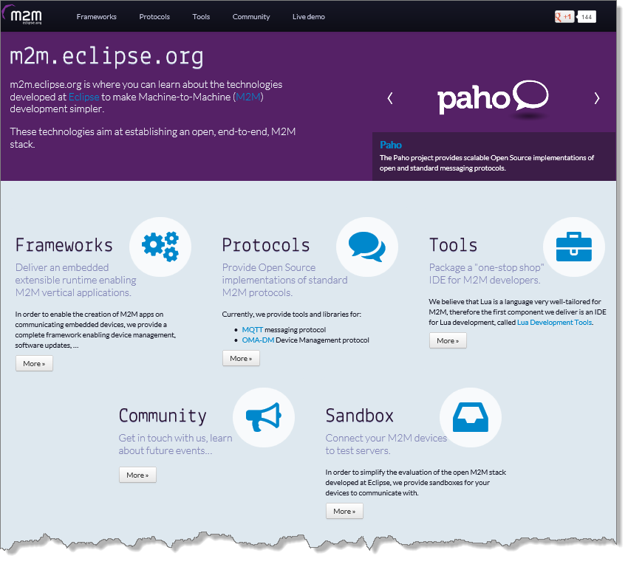
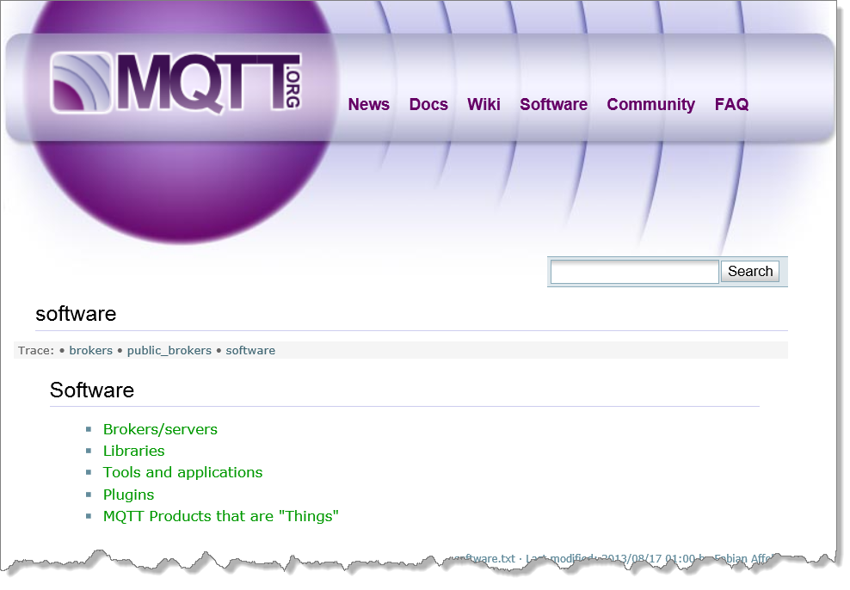
Libraries and tools

Slide 34
That sounds like a lot of data
How are we going to store, process, and analyze it all?

Slide 35
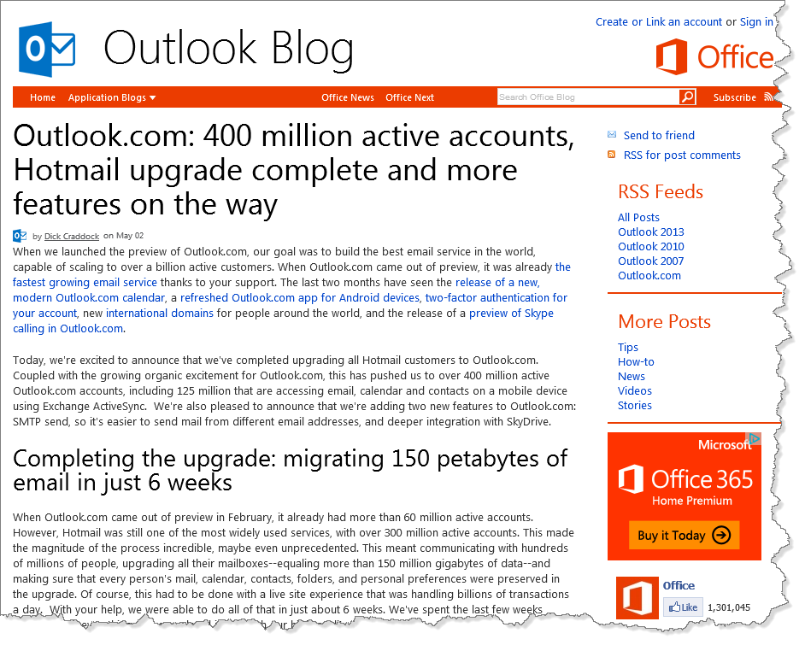
How much data is out there? HARD TO SAY!
Outlook.com has over 400 million
active accounts
Over 150 Petabytes of data stored!
Source: Outlook Blog

Slide 36
Giga, tera, exa, peta, zetta , yotta
16 Hours
1.8 Years
1913 Years
1.9 Million Years
2 Billion Years
That’s a “yotta” music!
Cisco predicts that annual internet traffic volume will hit 1.3 Zettabytes by 2016 (source)
If a one minute mp3 music file is about 1.1MB then…

Slide 37

OUCH. THAT HURTS MY BRAIN
Image courtesy of Jack Germsheid

Slide 38
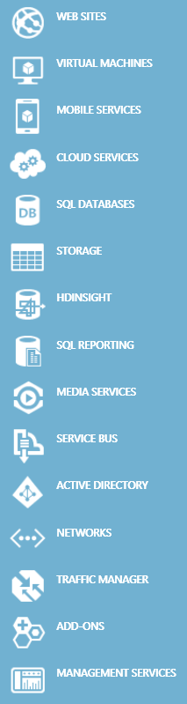
Cloud computing
Compute Services
The current state of cloud computing revolves mainly around the running of Virtual Machines (IaaS) or applications (PaaS) in the cloud vendor’s data centers.
Application Services
In addition to running your code, cloud services can store your files & data, help authenticate your users, route data between your networks, stream your videos, and much more.

Slide 39


CLOUD OVERVIEW
Traditional Software
Infrastructure (as a service)
Platform (as a service)
Software (as a service)
Applications
Applications
Applications
Applications
You manage
Data
Data
Data
Data
Runtime
You manage
Runtime
Runtime
Runtime
Middleware
Middleware
Middleware
Middleware
You manage
O/S
O/S
O/S
O/S
Managed by vendor
Virtualization
Virtualization
Virtualization
Virtualization
Servers
Servers
Servers
Servers
Managed by vendor
Managed by vendor
Storage
Storage
Storage
Storage
Networking
Networking
Networking
Networking

Slide 40
Cloud storage
Azure Blob Storage Amazon S3
Azure SQL Database Amazon RDS
Files
Azure Table Storage MongoDB, etc
Azure Queues Azure Service Bus
NoSQL
Queues

Slide 41
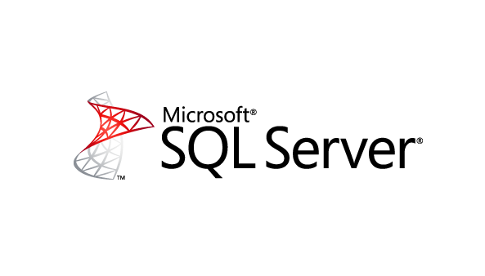

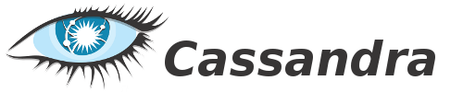






Big data – Volume, velocity, variety
mapreduce

Slide 42
mapreduce
Hadoop / Azure HDInsight
REDUCE TO COUNT
16
REDUCE TO COUNT
12
MAP UNITS BY COLOR
OUTPUT
REDUCE TO COUNT
12
REDUCE TO COUNT
09

Slide 43
Microsoft and IoT
We’re not just “on the bandwagon”, we’re driving it!

Slide 44
Cloud Based IoT Solutions
Azure IoT
Easy to provision, use and manage
Pay as you go, scale as you need
Global reach, hyper scale
End to end security & privacy
Three parts of an IoT solution
1 | Device connectivity & management
2 | Analytics & operationalized insights
3 | Presentation & business connectivity

Slide 45
IoT Device & Cloud Patterns
Cloud Gateway
Event Hubs
Event Hubs
High scale telemetry ingestion service
HTTP/AMQP protocol support
Each Event Hub supports
1 million publishers
1GB/s ingress
Generally available worldwide
18 Billion messages per day
60+ TB ingested per day
Field Gateway
Protocol Adaptation
Devices
RTOS, Linux, Windows, Android, iOS
Field Gateway
Device
Connectivity & Management

Slide 46
IoT Device & Cloud Patterns
Cloud Gateway
Event Hubs
Additional IoT Needs
Command & control
Device identity
Device registry
Device management
Field Gateway
Protocol Adaptation
Devices
RTOS, Linux, Windows, Android, iOS
Coming with the Azure IoT Suite…
Field Gateway
Device
Connectivity & Management

Slide 47
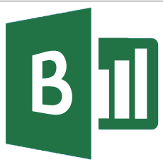
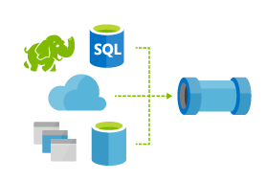
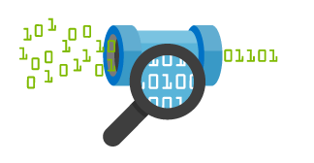


IoT Device & Cloud Patterns
Batch Analytics & Visualizations
Azure HDInsight, AzureML, Power BI,
Azure Data Factory
Cloud Gateway
Event Hubs
Hot Path Analytics
Azure Stream Analytics, Azure HDInsight Storm
Presentation &
Business Connectivity
App Service, Websites
Dynamics, BizTalk Services, Notification Hubs
Hot Path Business Logic
Service Fabric & Actor Framework
Field Gateway
Protocol Adaptation
Devices
RTOS, Linux, Windows, Android, iOS
Field Gateway
Device
Connectivity & Management
Analytics &
Operationalized Insights
Presentation &
Business Connectivity

Slide 48















Microsoft Azure IoT services
Devices | Device Connectivity | Storage | Analytics | Presentation & Action
 | Event Hubs | SQL Database | Machine Learning | App Service
 | Service Bus | Table/Blob Storage | Stream Analytics | Power BI
 | External Data Sources | DocumentDB | HDInsight | Notification Hubs
 |  | External Data Sources | Data Factory | Mobile Services
 |  |  |  | BizTalk Services
{ }

Slide 49
Devices
Notes:
We talked a lot about the I in IoT, but what about the Things – the devices generating all of this data?

Slide 50
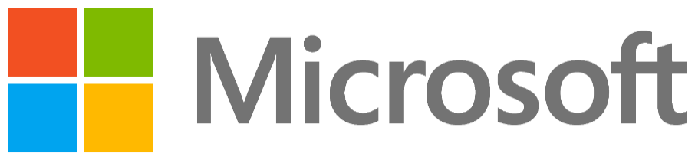
Microsoft’s view
The Internet of Things starts with your things.
Build on the infrastructure you already have
Add more devices to the ones you already own
Get more from the data that already exists
Stop just running your business. Start making it thrive. Start realizing the potential of the Internet of Your Things.
.
Notes:
Key goal of slide::
Land Microsoft’s unique and differentiated point-of-view on the Internet of Things: the Internet of Your Things.
Microsoft believes the Internet of Things doesn’t have to be overwhelming. Businesses can start small, with a few changes that make a big impact. It’s not about the billions of things that can be connected, it’s about YOUR THINGS. And, it’s already happening!
Slide talk track:
The Internet of Your Things is not about ripping and replacing technologies in your enterprise. It’s about leveraging what you have, adding on to your existing systems, using your existing things in new ways, and innovating and optimizing so everything works better together. If you’re a retailer, think about how smarter POS terminals can increase cross-selling and up-selling. If you’re in healthcare, think about how connecting patient monitors, tablets, signage and other equipment can streamline patient care. For manufacturers, sensors on the factory floor can “talk” to diagnostic monitors to improve production efficiency and reduce down time.
The Internet of Things starts with your things. It is about the things that matter most to your business.
Build on the infrastructure you already have.
Connect the devices you already own…then add to your existing investments.
Tap into the data that already exists.
The Internet of Your Things is about getting away from spending all your time just running your business, and thinking about finding ways to make it thrive. Start realizing the potential of the Internet of Your Things.

Slide 51
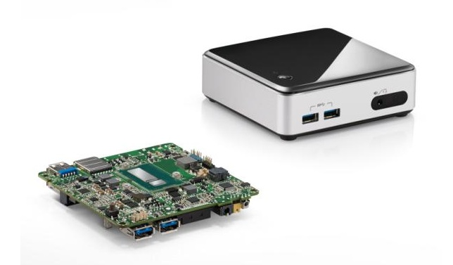
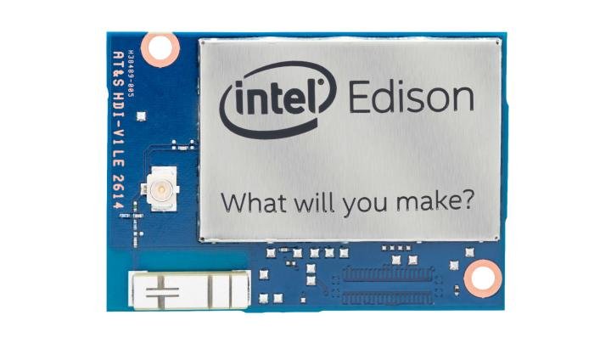



Linux and more
Notes:
Support from previous slide. Advance to this slide while working through talk track from previous slide.
Advance here
Raspberry Pi (B+, module, etc.)
Tessel
Arduino
Edison
Linux embedded PCs
Etc.

Slide 52
Microsoft’s view
We also provide device support to scale based on your need
Start with sensors for low-volume
Create gateway apps on tiny devices
Scale gateways and aggregation all the way up to powerful PCs as your needs require
Windows 10 IoT, NETMF
Notes:
Of course, we also provide our own devices which can scale up from solutions based on NETMF or Windows, all the way up to large processing clusters running the same software and applications.
Let’s talk about Windows

Slide 53

The journey to one Windows…
Windows Desktop
Windows Phone
ONE CORE OS
ONE APP PLATFORM
ONE STORE
Windows 10
Xbox
IoT
HoloLens
Surface Hub
Notes:
Let’s talk about Windows a bit here, because Windows is one of our main IoT client platforms.
We also have things like Band, and of course, the .NET Micro framework, but we’re going big on IoT with Windows 10.
Windows 10 is the convergence of all of our operating system development, including IoT and desktop.
It’s the best of everything we’ve had to offer to date. It’s something we believe in so much that we’ve made Windows 10 a free upgrade from Windows 7, 8, and 8.1 as long as the upgrade happens during the first year after Windows 10 releases.

Slide 54













on a full range of devices…
2-in-1s (Tablet or Laptop)
Classic Laptop
Desktops & All-in-Ones
Phone
Phablet
Small Tablet
Large Tablet
Windows 10
Surface Hub
Xbox
Holographic
IoT
Notes:
Windows 10 supports a full range of devices from phones to tablets to laptops, hololens, Xbox and tiny IoT and maker devices like the Raspberry Pi 2

Slide 55
tuned to each form factor…
Windows for PCs
Familiar desktop shell
Broad hardware ecosystem
Windows desktop application compatibility
Windows for phones
Familiar mobile shell
Rich telephony
Windows phone app compatibility
Windows on Xbox
10’ shell experience
Shared gaming experiences
Xbox One game and app compatibility
Windows for …
Form factor–appropriate shell experience
Device-specific scenario support
One Core OS
Base OS
App and Device platform
Runtimes and frameworks
Notes:
Familiar experience, but tuned for each form factor:
10’ experience, Phones, Tablets, Desktops, IoT.
The Xbox experience is not going to be the same as the phone experience. And for IoT, you the developer have 100% complete control over the experience because there is no Windows shell.

Slide 56
with a universal app platform...
Windows Universal Platform
Common & Consistent APIs
Languages
C++ /CX
C#, VB
JS
More
UI Frameworks
HTML
Xaml
DirectX
APIs
WinRT
Win32
.NET
Wiring
Deployment and Execution
APPX
Xcopy
App Isolation
Notes:
A unified API set (Universal App Platform) where you compile different binaries only for architectures (x86/64/ARM) and not for each device.
In Windows 10, we have the Universal App Platform (UAP) which is the programming model that covers all of our Windows 10 devices from screens in board rooms, to desktops, tablets, phones, Xbox, tiny IoT devices, and more. You can write a single application that provides maximum reach.
Converged APIs, write ONE Universal App and target all Windows 10 editions
Scale and get higher ROI by selling same App to all Windows 10 editions OEMs/ODMSs
Reuse existing development skills
Across all of those devices you can use the same programming model and languages, making it simple to scale applications from tiny devices to multi-core 64 bit Intel monster workhorses.
Part of UAP is our programming model for IoT. Through that, you get low-level access to GPIO, PWM, SPI, I2C, and more.

Slide 57

and some pretty cool devices.
Notes:
Windows 10 for IoT will be available initially on three boards:
Raspberry Pi 2
Minnowboard Max (essentially the guts of a tablet)
Dragonboard (essentially the guts of a phone)
All of these boards support universal apps and the new IoT APIs in UAP. All three have first-class developer experience in Visual Studio.
We also support other Windows 10 IoT SKUs for mobile and larger systems, all of which support the same UAP programming model and binaries.

Slide 58


.NET Micro Framework and Gadgeteer
Notes:
In addition to Windows, which runs on phone and tablet-class x86/64 and ARM processors, we have technology which runs on low-cost, low-power ARM microcontrollers.
NETMF
Our platform for very tiny devices. We’re working to improve performance here, and also to help drive NETMF down to even lower power, lower cost processors.
Gadgeteer
Platform for prototyping, iot startups, and makers, built on top of NETMF
Working to complete open sourcing
Soon to be hosted on GitHub as a true OSS project with community contributions.
Once of the choices in today’s lab.
Both NETMF and Gadgeteer support full Visual Studio development, debugging, and deployment experiences.

Slide 59
Gadgeteer on Windows
Notes:
Prototype shown
Not available in the lab today, but we’re working with our partner GHI, and with the community, to port the Open Source Gadgeteer framework to Windows 10.
Benefits:
Provides a way to scale up from Gadgeteer on NETMF, while still using same sensors
Raspberry Pi 2 is primary board
Better Azure integration, better AllJoyn integration, all the power of Windows UAP.
Early bits to be available this spring/summer
Full designer experience later in 2015, depending on contributions from community

Slide 60
The Connect the Dots lab
Notes:
At this point, you should be at approximately the 60 minute mark or earlier. The remaining content should take no longer than 30 minutes.

Slide 61
arduino

Slide 62
GALILEO BOARD

Slide 63
RASPBERRY PI

Slide 64

FEZ SPIDER MAIN BOARD

Slide 65
Sparkfun weather shield

Slide 66
Connect the dots azure icons
Event Hubs
Stream Analytics
Storage
(
Azure
Microsoft Azure
Web App
Service Bus
)
Storage blob
Storage table
SQL database
HDInsight
Machine
(
Learning
GitHub code
Git repository
generic
)

Slide 67
LEDs

Slide 68
Resistors
220Ω
1st Digit
2nd Digit
Multiplier
Tolerance
Color | Name | 1st Digit | 2nd Digit | Multiplier | Tolerance
 | Black | 0 | 0 | X1
 | Brown | 1 | 1 | X10 | 1%
 | Red | 2 | 2 | X100
 | Orange | 3 | 3 | X1,000
 | Yellow | 4 | 4 | X10,000
 | Green | 5 | 5 | X100,000
 | Blue | 6 | 6 | X1,000,000
 | Violet | 7 | 7
 | Grey | 8 | 8
 | White | 9 | 9
 | Gold |  |  | X0.1 | 5%
 | Silver |  |  | X0.01 | 10%
330Ω
10KΩ

Slide 69
cables

Slide 72
Micro SD Cards
Font: Segoe UI Semibold

Slide 73
Connect the Dots Sample Web Site
Web App
<name>-ns Service Bus Namespace
LISTEN
LISTEN
SEND
“ehdevices”
Event Hub
“ehalerts”
Event Hub
SEND
LISTEN
SEND
LISTEN
SEND
“<name>Aggregates”
Stream Analytics Job
“<name>Alert”
“<name>LightSensor”
“<name>cg4pbi” Stream Analytics Jobs
LOGGING
LOGGING
“<name>storage”
Storage Account

Slide 74
Connect the dots logo

